Slide 1
Photon transport by nonequilibrium Green’s functions
Jian-Sheng Wang
Department of Physics, National University of Singapore

Slide 2
Outline
Fluctuation-dissipation theorem
Tight-binding model for electrons
NEGF theory of energy, momentum, and angular momentum transfer, Meir-Wingreen formulas
Applications
Angular momentum emission from graphene edges
Van der Waals force between C₆₀ s
Co-planar super-Planckian radiation in 2D metals
Floquet drive of a square lattice

Slide 3
Fluctuation-dissipation theorem (of 2nd kind)
$$\left\langle j_{β}^{†}\left(r^{′},ω^{′}\right)j_{α}(r,ω)\right\rangle =2ℏN\left(ω\right)ε_{0}ω^{2}ε_{αβ}^{′′}\left(ω\right)2πδ\left(ω−ω^{′}\right)δ(r−r^{′})$$
In NEGF notation (FDT 1st kind)
$$Π^{<}\left(ω\right)=N\left(ω\right)\left(Π^{r}\left(ω\right)−Π^{a}\left(ω\right)\right)$$
$+$ linear response:
$$j=−Π^{r}A$$
Callen and Welton 1951,
Kubo 1966,
Eckhardt 1984

Slide 4
Electron tight-binding model with baths
$$G^{r}\left(E\right)={\left(E−H−Σ^{r}\left(E\right)\right)}^{−1}$$
$$G^{<}\left(E\right)=G^{r}\left(E\right)Σ^{<}\left(E\right)G^{a}\left(E\right)$$
$$Σ^{<}\left(E\right)=−f(E)\left(Σ^{r}\left(E\right)−Σ^{a}\left(E\right)\right)$$
$$Σ^{a}\left(E\right)={\left(Σ^{r}\left(E\right)\right)}^{†}$$
system
bath
$$\sum_{j,k}{c_{j}^{†}H_{jk}c_{k}}$$

Slide 5
Electron-field interaction, Peierls substitution
system
$$\sum_{jk}{c_{j}^{†}H_{jk}c_{k}exp\left(−ie/ℏ\int_{k}^{j}{A⋅dr}\right)}$$
bath
$A$ : vector field

Slide 6
NEGF, definitions
See AGD chapter 6
$φ=0$ gauge

Slide 7
Fluctuation-dissipation theorem in thermal equilibrium
Eckhardt 1984
Agarwal 1975

Slide 8
Dyson equations
contour ordered

Slide 9
Poynting theorem and heat transfer
$$\frac{∂u}{∂t}+∇∙S=−E∙j$$
$$u=\frac{1}{2}\left(ε_{0}E^{2}+\frac{1}{μ_{0}}B^{2}\right), S=\frac{1}{μ_{0}}E×B$$
α
$$I_{α}=\int{dΣ⋅\left\langle E×B\right\rangle \frac{1}{μ_{0}}=−\int{dV\left\langle E⋅j\right\rangle }}=\int{dV\left\langle \frac{∂A}{∂t}⋅j\right\rangle }$$

Slide 10
Deriving the Meir-Wingreen formula
Use the Joule heating form, $E∙j$, and write $j=−Av^{−1}$, we get
$I_{α}=−\int{d^{3}r \left\langle E∙j\right\rangle }=−\int{{\left.\frac{∂}{∂t}\sum_{μ,ν}{\left\langle A_{μ}\left(r,t\right)A_{ν}\left(r^{′},t^{′}\right)\right\rangle v_{νμ}^{−1}\left(r^{′},t^{′}\right)}\right|}_{r^{′}=r,t^{′}=t}}d^{3}r$
$$=\int{d^{3}r\left(\frac{ℏ}{2i}\right)\frac{∂}{∂t}Tr\left(D^{K}v^{−1}\right)}$$
Use Dyson equation $D^{a}v^{−1}=I+D^{a}Π^{a}$ and Keldysh equation $D^{K}=D^{r}Π_{tot}^{K}{ D}^{a}$, we get

Slide 11
Meir-Wingreen formula
$I_{α}=− \int{d^{3}r \frac{iℏ}{2}}\frac{∂}{∂t}Tr\left(D^{r}Π_{α}^{K}+D^{K}Π_{α}^{a}\right)$
Floquet matrix (Tsuji et al 2008, Tang et al 2024)
$$D\left(t,t^{′}\right)=\int_{−\frac{Ω}{2}}^{+\frac{Ω}{2}}{\frac{dω}{2π}\sum_{mn}{D_{mn}\left(ω\right)e^{−iω_{m}t+iω_{n}t^{′}}}}$$
where $ω_{m}=ω+mΩ$.
$$D_{m,n}\left(ω+kΩ\right)=D_{m+k,n+k}(ω)$$

Slide 12
Self-energy $Π$
diamagnetic
RPA

Slide 13
Meir-Wingreen formula
Krüger, et al (2012); Strekha, et al (2022);
Wang, et al, Front. Phys. (2023).
Notes:
Levi Civita symbol

Slide 14
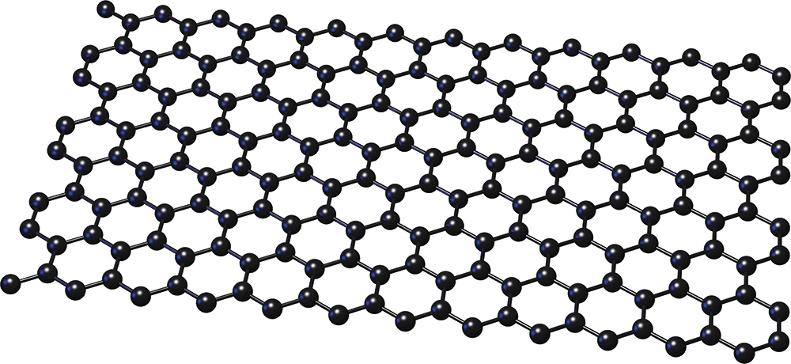
Force and torque from the nonequilibrium edge
$$J$$
$$p$$
$$μ_{L}$$
$$μ_{R}$$
Zhang, et al, PRB 105, 205421 (2022).

Slide 15
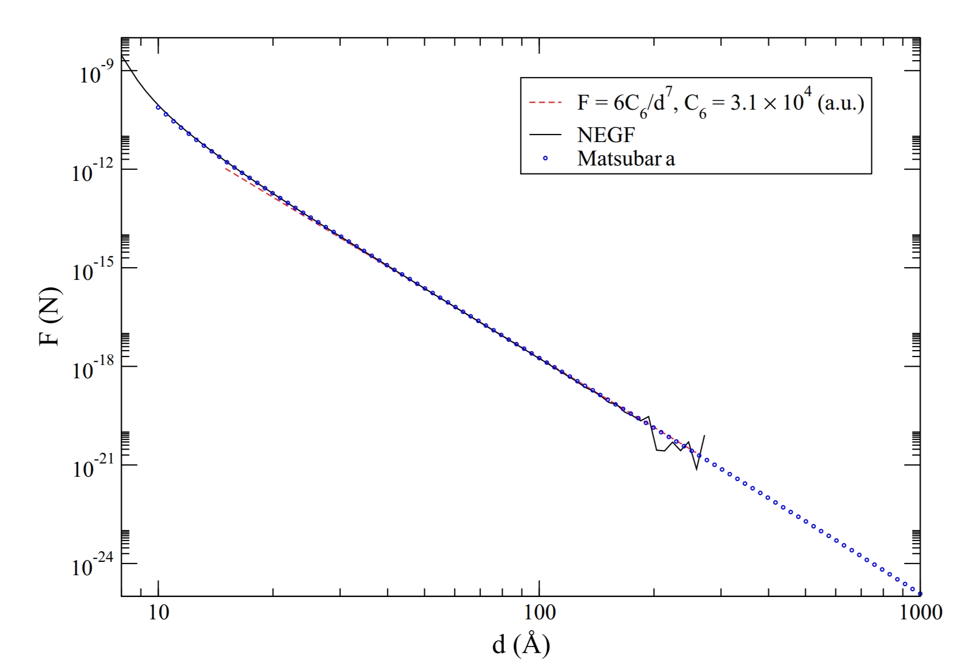
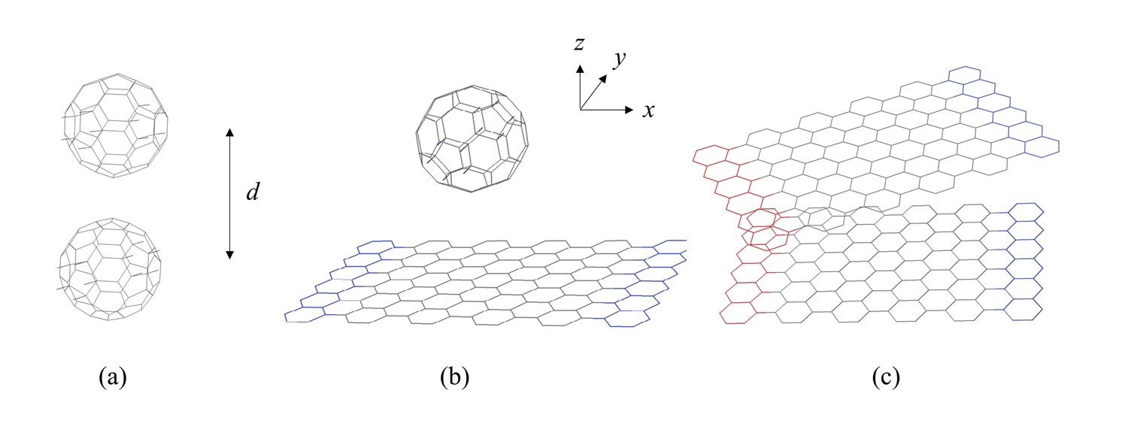
C₆₀ and graphene
Wang and Antezza, Phys. Rev. B 109, 125105 (2024)

Slide 16
Heat transfer of 2D metals, co-planar geometry
1000 K
300 K
y
x
z
640 × 640
d

Slide 17
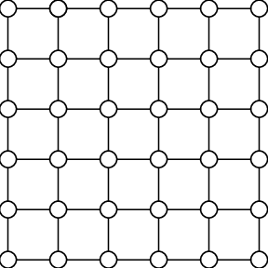
Drude model approximation to photon self-energy $Π$
$$Π_{lμ,l^{′}ν}^{r}\left(ω\right)=\frac{a^{2}e^{2}ω\left(\frac{n}{m}\right)}{2iη+ω}δ_{l,l^{′}}δ_{μ,ν}$$
$n$: electron surface density
$m:$ electron effective mass
$2η=1/τ:$ inverse relation time
$a:$ lattice constant (4 a.u.)
a

Slide 18
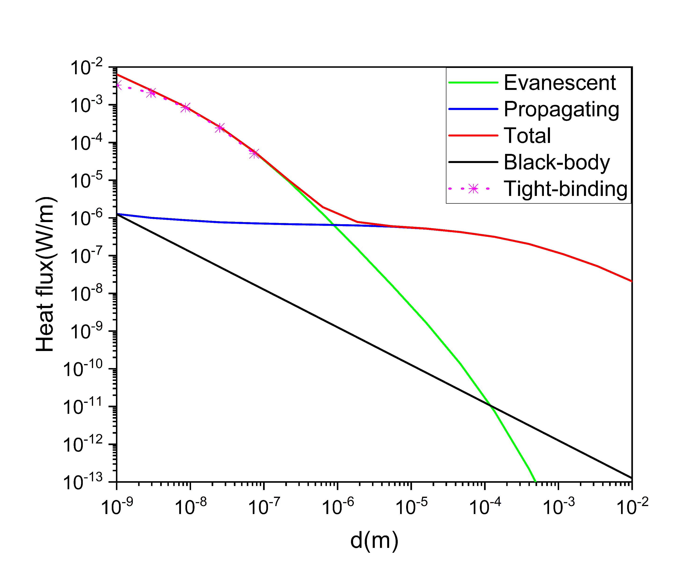
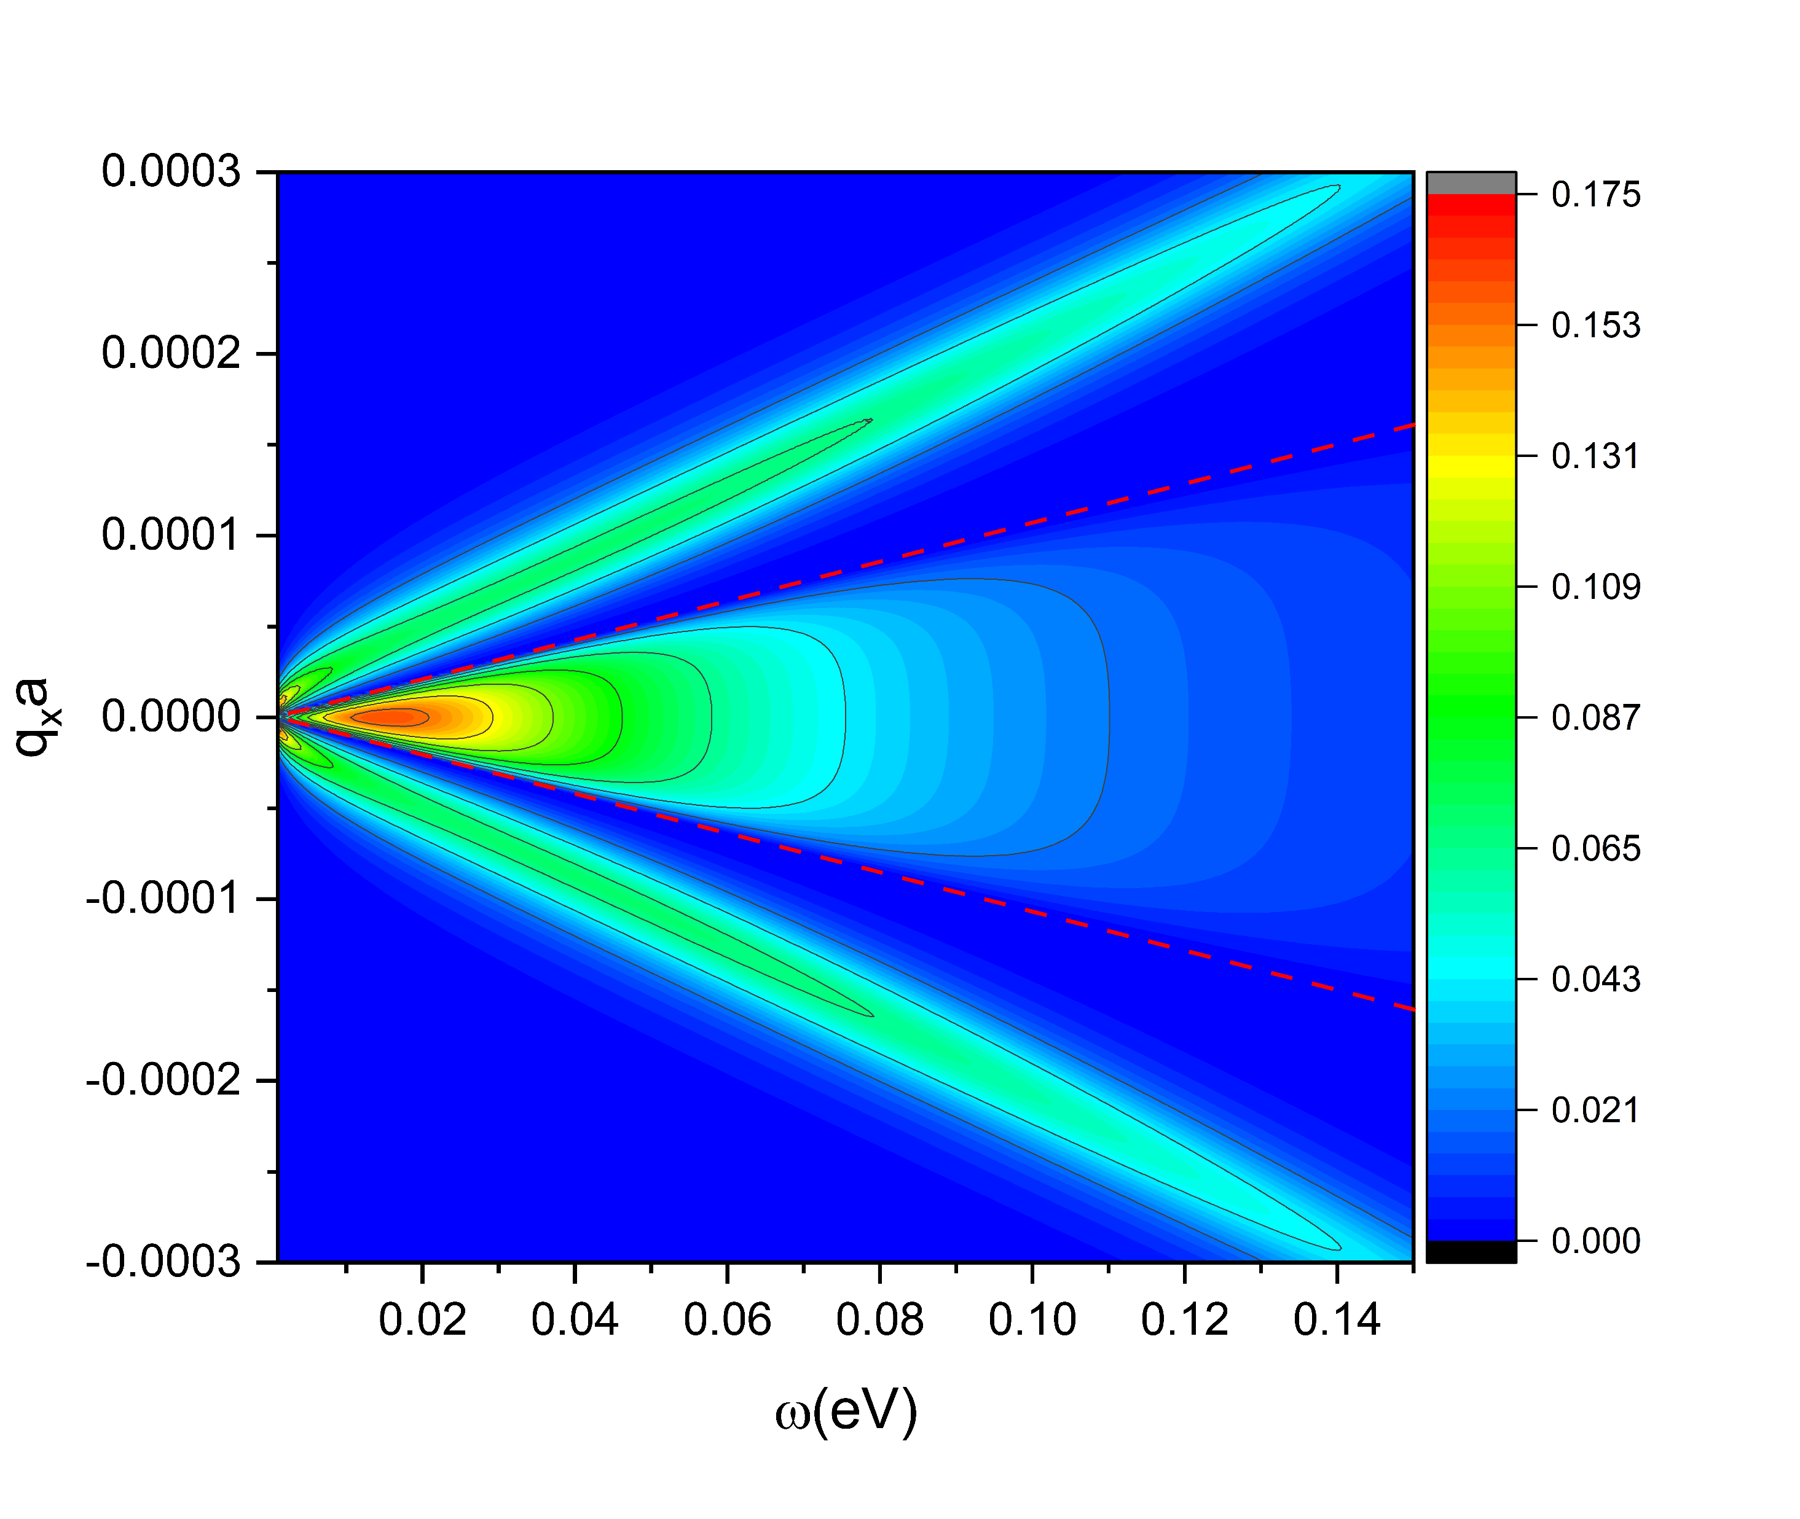
← The distance dependence of radiative heat flux density between two coplanar metal sheets with temperatures
T₁ = 1000 K and T₂ = 300 K.
The black solid lines depict the heat flux density of black-body radiation calculated by the Stefan-Boltzmann law with view factor.
→ The spectrum of transmission function T(q,ω) between two coplanar metal sheets with a gap size of 1 µm. The red dashed lines represent the light line q² = ω²/c², the boundary between evanescent and propagating modes.
Both figures from Zhu et al, arXiv:2403.15036

Slide 19
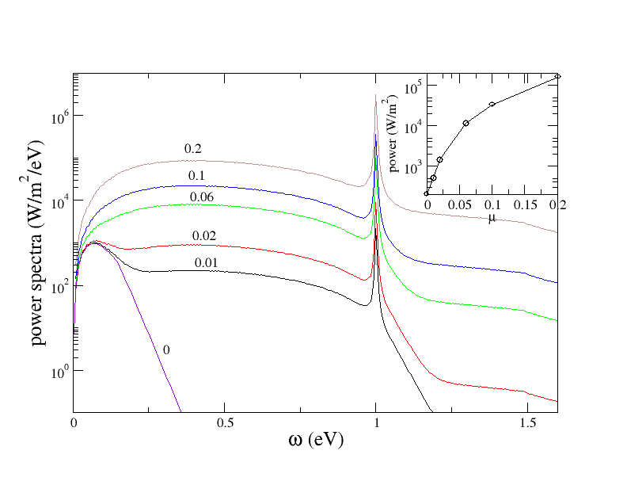
Floquet drive of a single square lattice metal
$a=1.4$Å, $t=1$ eV
$$ε_{k}$$
$${μ(t)}_{}$$
k
$$μ\left(t\right)=2μ\cos{(Ωt)}$$
$ℏΩ=1$ eV
Wang, et al, unpublished.

Slide 20
Conclusion
NEGF formulation for photon transport between condensed matter objects at the nanoscale
Energy, momentum, and angular momentum transfer in a unified framework with the Meir-Wingreen formula
Applications in nonequilibrium settings

Slide 21
Acknowledgments
Gaoming Tang, Graduate School of China Academy of Engineering Physics, Beijing
Tao Zhu, Tiangong University, Tianjin, China
Yong-Mei Zhang, Nanjing Univ of Aeronautics and Astronautics
Mauro Antezza, Univ Montpellier, CNRS, France
MOE FRC tier 1 support

