Slide 1
Week 10
Canonical distribution

Slide 2
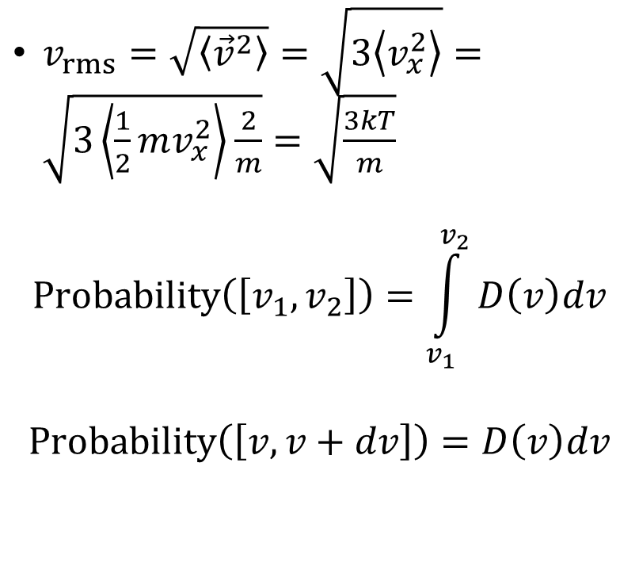
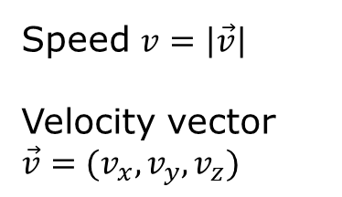
The Maxwell speed distribution
Speed $v=\left|\vec{v}\right|$
Velocity vector $\vec{v}=(v_{x},v_{y},v_{z})$
$v_{rms}=\sqrt{\left\langle {\vec{v}}^{2}\right\rangle }=\sqrt{3\left\langle v_{x}^{2}\right\rangle }=\sqrt{3\left\langle \frac{1}{2}mv_{x}^{2}\right\rangle \frac{2}{m}}=\sqrt{\frac{3kT}{m}}$
$$Probability\left(\left[v_{1},v_{2}\right]\right)=\int_{v_{1}}^{v_{2}}{D\left(v\right)dv}$$
$$Probability\left(\left[v,v+dv\right]\right)=D\left(v\right)dv$$
A graph of the probability density for a gas molecule to have various speeds.

Slide 3
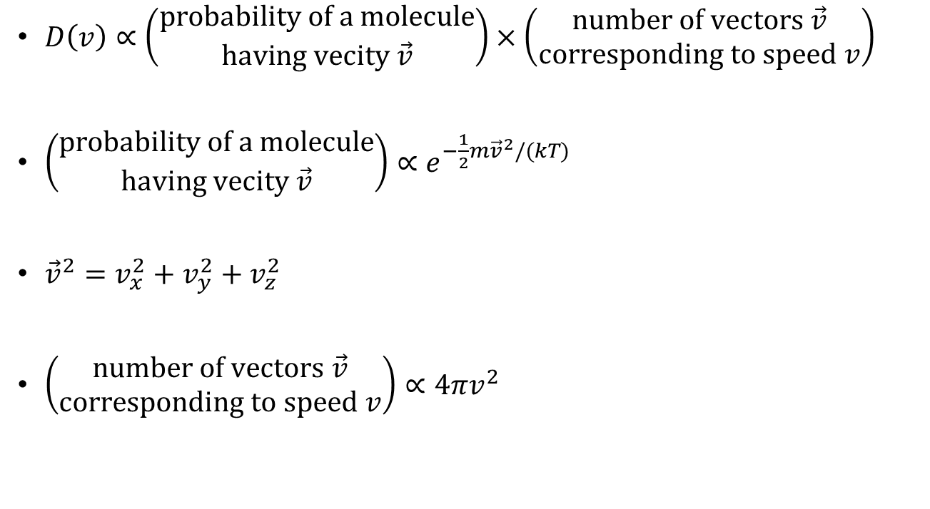
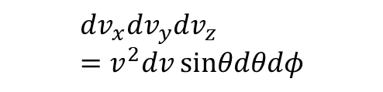
Speed & velocity distributions
$D\left(v\right)∝\left(\begin{matrix}probability of a molecule \\ having vecity \vec{v}\end{matrix}\right)×\left(\begin{matrix}number of vectors \vec{v} \\ corresponding to speed v\end{matrix}\right)$
$\left(\begin{matrix}probability of a molecule \\ having vecity \vec{v}\end{matrix}\right)∝e^{−\frac{1}{2}m{\vec{v}}^{2}/(kT)}$
${\vec{v}}^{2}=v_{x}^{2}+v_{y}^{2}+v_{z}^{2}$
$\left(\begin{matrix}number of vectors \vec{v} \\ corresponding to speed v\end{matrix}\right)∝4πv^{2}$
$$dv_{x}dv_{y}dv_{z}=v^{2}dv sinθdθdφ$$

Slide 4
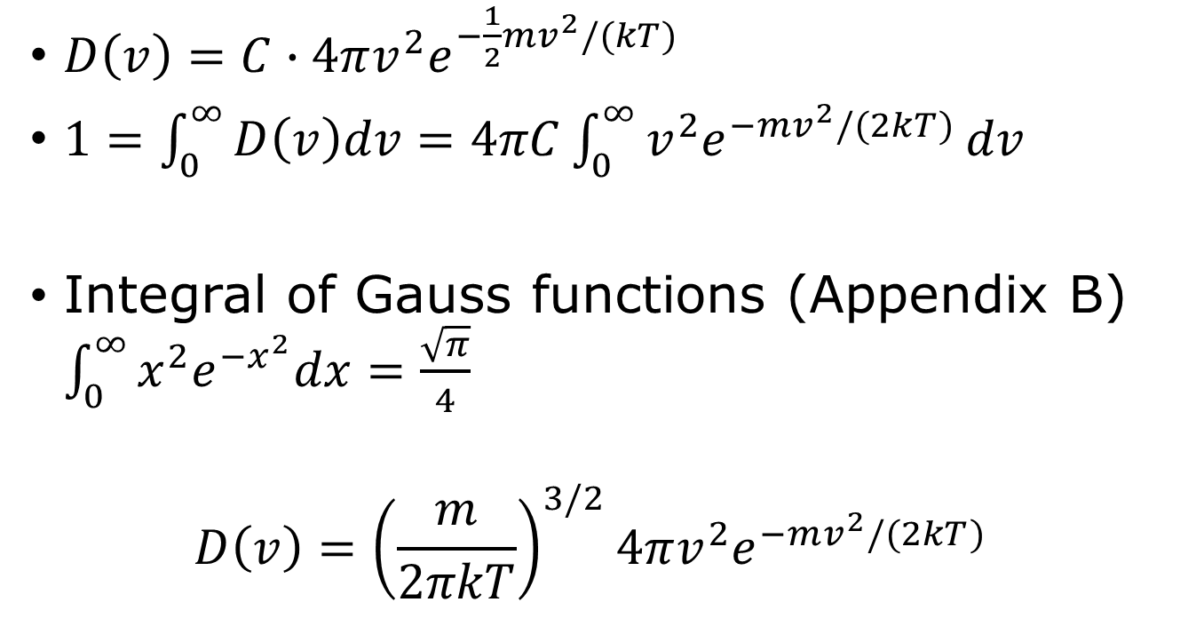
Fixing normalization
$D\left(v\right)=C∙4πv^{2}e^{−\frac{1}{2}mv^{2}/(kT)}$
$1=\int_{0}^{∞}{D\left(v\right)dv=4πC\int_{0}^{∞}{v^{2}e^{−mv^{2}/(2kT)}}}dv$
Integral of Gauss functions (Appendix B) $\int_{0}^{∞}{{x^{2}e}^{−x^{2}}dx=\frac{\sqrt{π}}{4}}$
$$D\left(v\right)={\left(\frac{m}{2πkT}\right)}^{3/2}4πv^{2}e^{−mv^{2}/(2kT)}$$

Slide 5
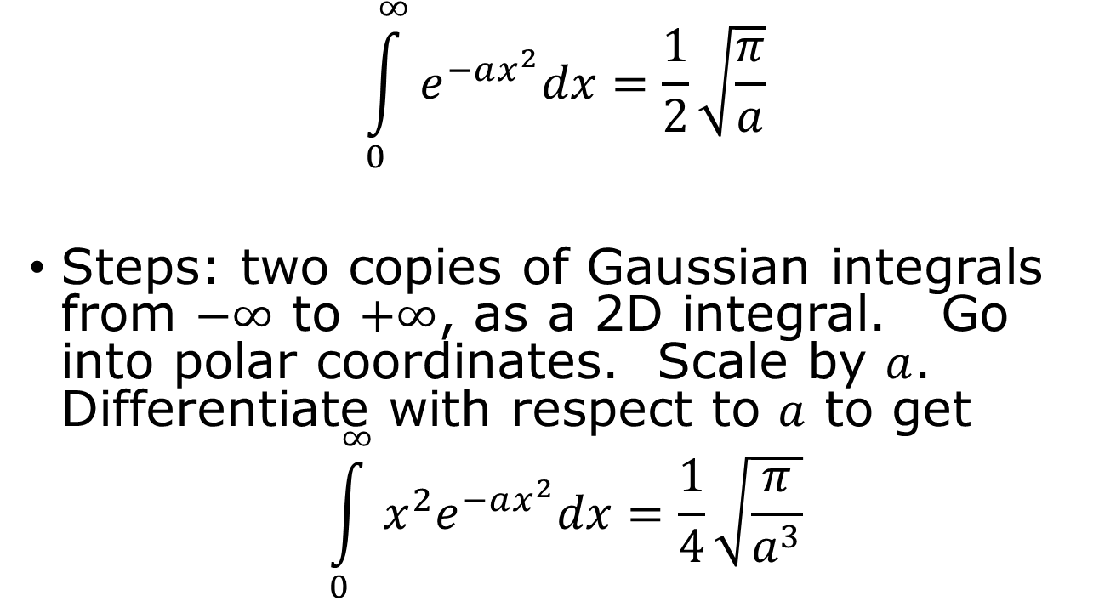
Prove the math formula Appendix B.1
$$\int_{0}^{∞}{e^{−ax^{2}}dx=\frac{1}{2}\sqrt{\frac{π}{a}}}$$
Steps: two copies of Gaussian integrals from $−∞$ to $+∞$, as a 2D integral. Go into polar coordinates. Scale by $a$. Differentiate with respect to $a$ to get
$$\int_{0}^{∞}{x^{2}e^{−ax^{2}}dx=\frac{1}{4}\sqrt{\frac{π}{a^{3}}}}$$

Slide 6
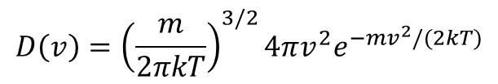

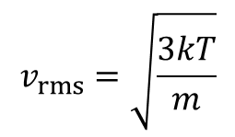
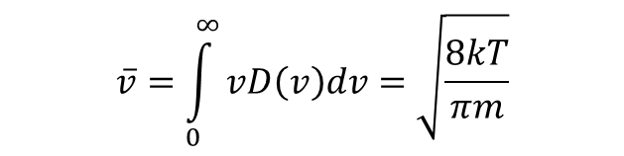
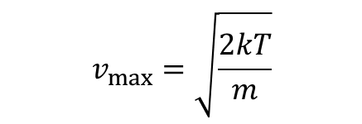
Maxwell’s distribution
$$D\left(v\right)={\left(\frac{m}{2πkT}\right)}^{3/2}4πv^{2}e^{−mv^{2}/(2kT)}$$
$$σ$$
$$v_{max}=\sqrt{\frac{2kT}{m}}$$
$$\overline{v}=\int_{0}^{∞}{vD\left(v\right)dv=\sqrt{\frac{8kT}{πm}}}$$
$$v_{rms}=\sqrt{\frac{3kT}{m}}$$

Slide 7

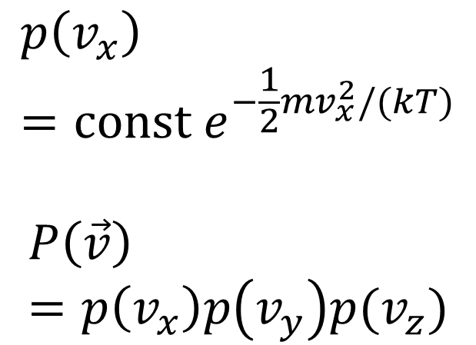


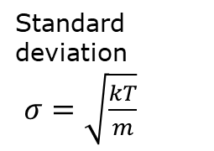


Maxwell velocity distribution in $x$ direction
$$p\left(v_{x}\right)=const e^{−\frac{1}{2}mv_{x}^{2}/(kT)}$$
$$P\left(\vec{v}\right)=p\left(v_{x}\right)p\left(v_{y}\right)p(v_{z})$$
$$p(v_{x})$$
Standard deviation
$σ=\sqrt{\frac{kT}{m}}$
$$v_{x}$$
0
$$σ$$
$$2σ$$

Slide 8
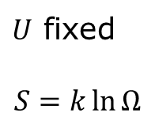



Partition function and free energy
$F=−kT\ln{Z}$ or $Z=e^{−F/(kT)}$
$F≡U−TS$
System in contact with reservoir
Isolated system
Temperature $T$fixed
V, N also fixed
$U$ fixed
$$S=k\ln{Ω}$$
$$F=−kT\ln{Z}$$

Slide 9
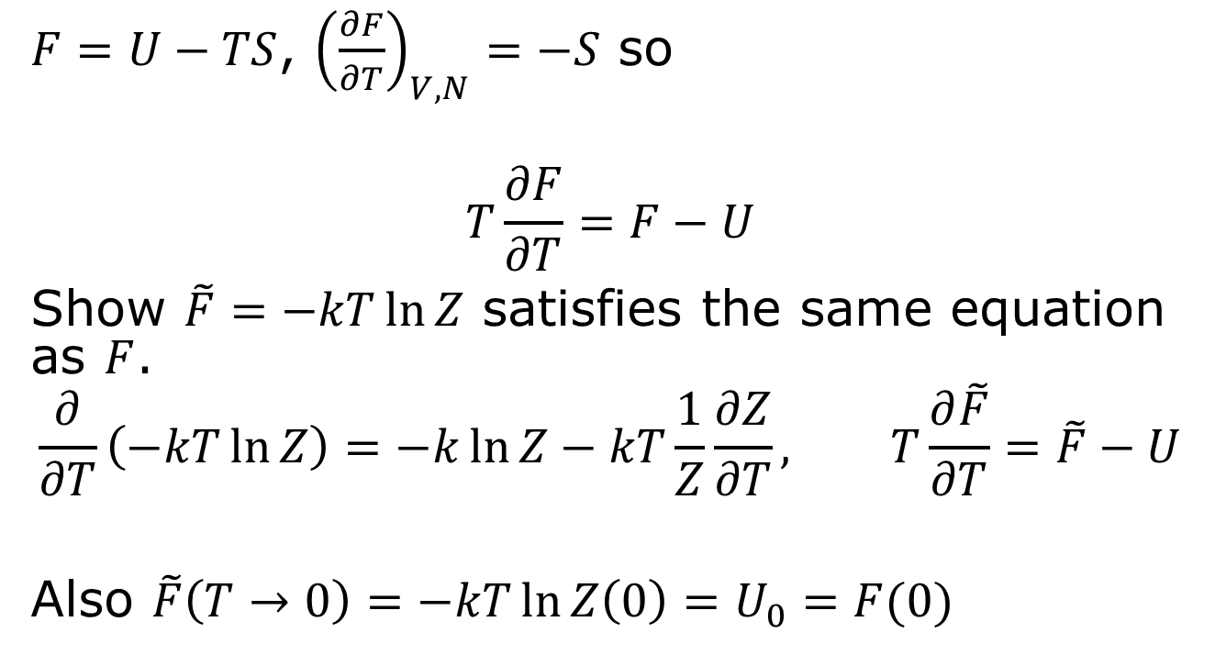

“Prove” that $F=−kT\ln{Z}$
$F=U−TS$, ${\left(\frac{∂F}{∂T}\right)}_{V,N}=−S$ so
$$T\frac{∂F}{∂T}=F−U$$
Show $\tilde{F}=−kT\ln{Z}$ satisfies the same equation as $F$.
$$\frac{∂}{∂T}\left(−kT\ln{Z}\right)=−k\ln{Z−kT}\frac{1}{Z}\frac{∂Z}{∂T}, T\frac{∂\tilde{F}}{∂T}=\tilde{F}−U$$
Also $\tilde{F}\left(T→0\right)=−kT\ln{Z\left(0\right)}=U_{0}=F(0)$

Slide 10

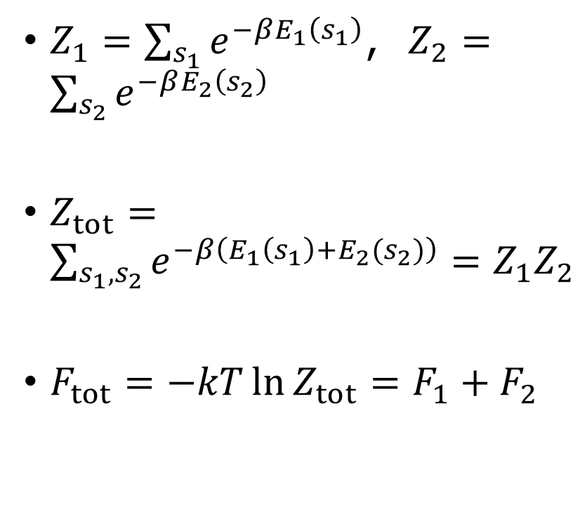


Partition function for composite systems
$Z_{1}=\sum_{s_{1}}{e^{−βE_{1}\left(s_{1}\right)}}$, $Z_{2}=\sum_{s_{2}}{e^{−βE_{2}\left(s_{2}\right)}}$
$Z_{tot}=\sum_{s_{1},s_{2}}{e^{−β\left(E_{1}\left(s_{1}\right)+E_{2}(s_{2})\right)}=Z_{1}Z_{2}}$
$F_{tot}=−kT\ln{Z_{tot}=F_{1}+F_{2}}$
system 1, $s_{1}$
System 2, $s_{2}$
Same temperature $T$

Slide 11
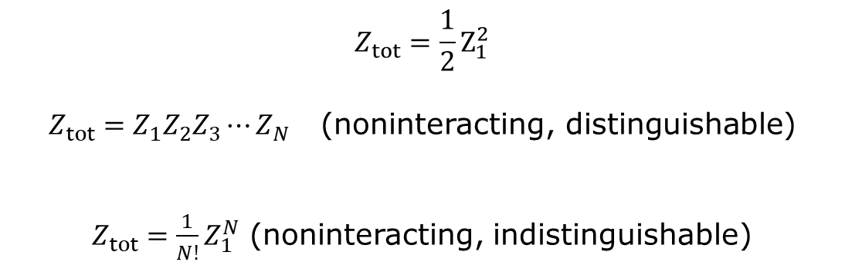

Two identical particles as a composite system
Interchange the states of two indistinguishable particles leave the system in the same state as before.
1
2
$$=$$
2
1
$$Z_{tot}=\frac{1}{2}Z_{1}^{2}$$
$Z_{tot}=Z_{1}Z_{2}Z_{3}⋯Z_{N}$ (noninteracting, distinguishable)
$Z_{tot}=\frac{1}{N!}Z_{1}^{N}$ (noninteracting, indistinguishable)

Slide 12
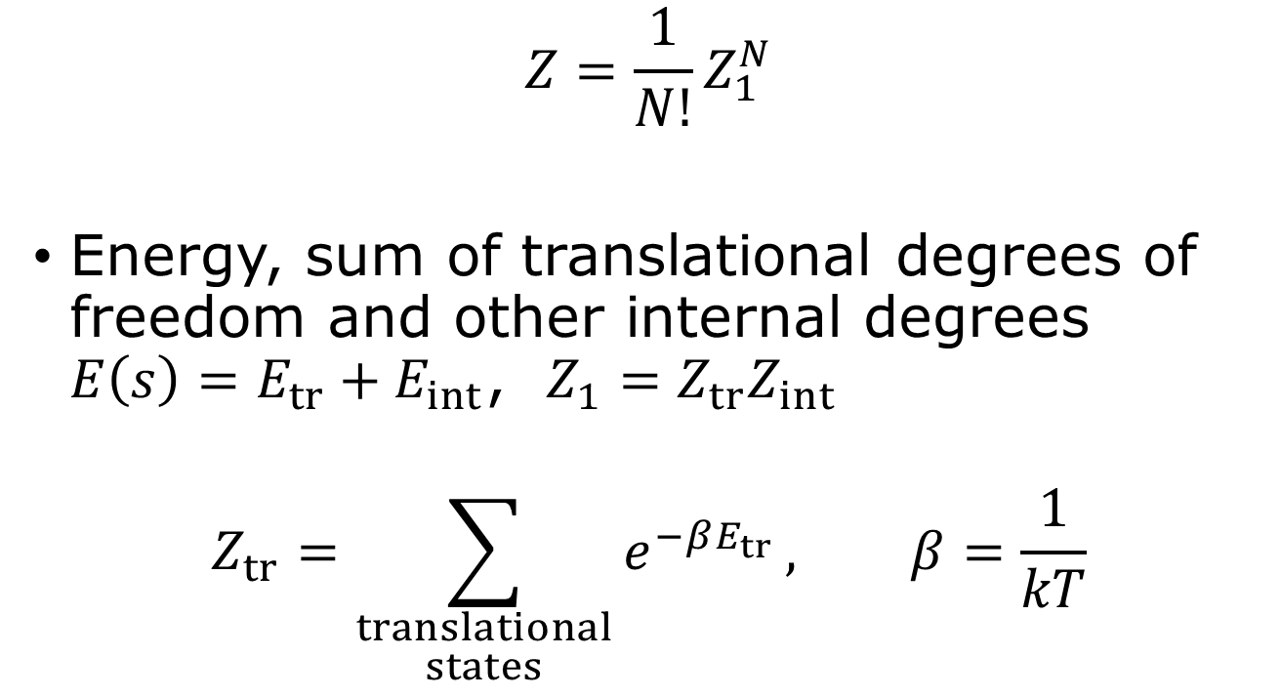
Ideal gas, canonical way
$$Z=\frac{1}{N!}Z_{1}^{N}$$
Energy, sum of translational degrees of freedom and other internal degrees $E\left(s\right)=E_{tr}+E_{int}$, $Z_{1}=Z_{tr}Z_{int}$
$$Z_{tr}=\sum_{\begin{aligned}translational \\ states\end{aligned}}{e^{−βE_{tr}}}, β=\frac{1}{kT}$$

Slide 13
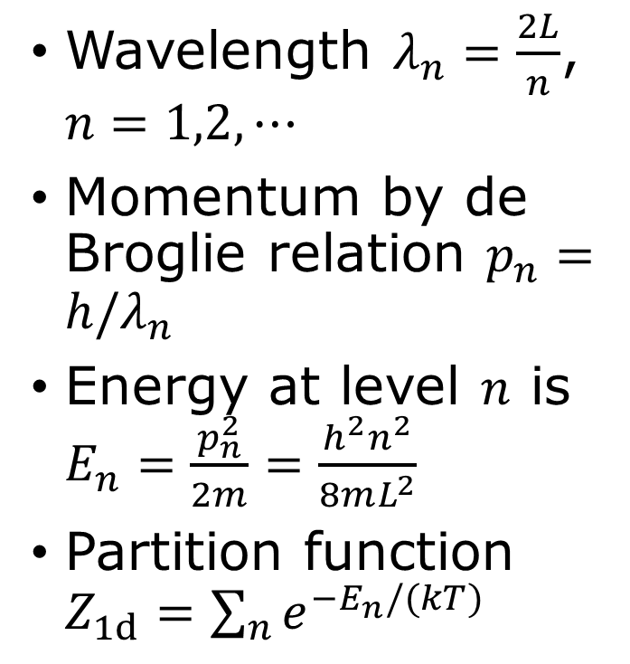
Particle in a box
Wavelength $λ_{n}=\frac{2L}{n}$, $n=1,2,⋯$
Momentum by de Broglie relation $p_{n}=h/λ_{n}$
Energy at level $n$ is $E_{n}=\frac{p_{n}^{2}}{2m}=\frac{h^{2}n^{2}}{8mL^{2}}$
Partition function $Z_{1d}=\sum_{n}{e^{−E_{n}/(kT)}}$
Particle is “wave”: the three lowest-energy wavefunctions for a particle confined to a one-dimensional box.

Slide 14
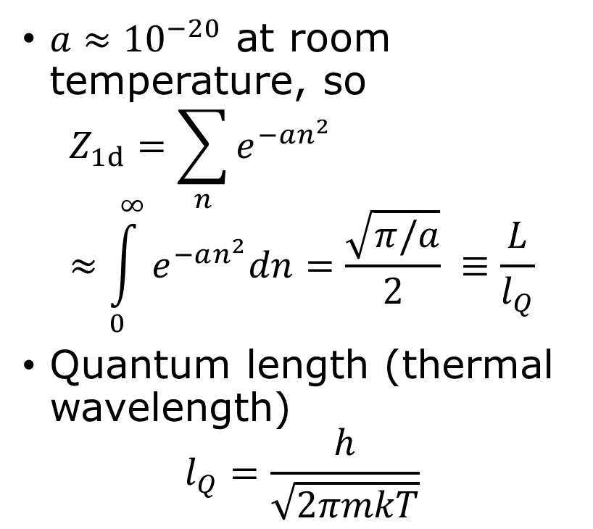
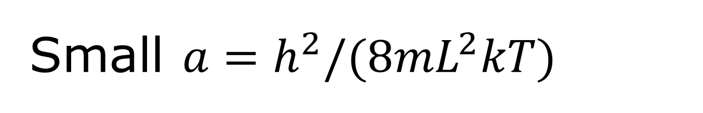



Small $a=h^{2}/(8mL^{2}kT)$
$a≈{10}^{−20}$ at room temperature, so
$$Z_{1d}=\sum_{n}{e^{−an^{2}}}≈\int_{0}^{∞}{e^{−an^{2}}dn=\frac{\sqrt{π/a}}{2} }≡\frac{L}{l_{Q}}$$
Quantum length (thermal wavelength)
$$l_{Q}=\frac{h}{\sqrt{2πmkT}}$$
$$e^{−an^{2}}$$
$Δn=1$
$$n$$

Slide 15


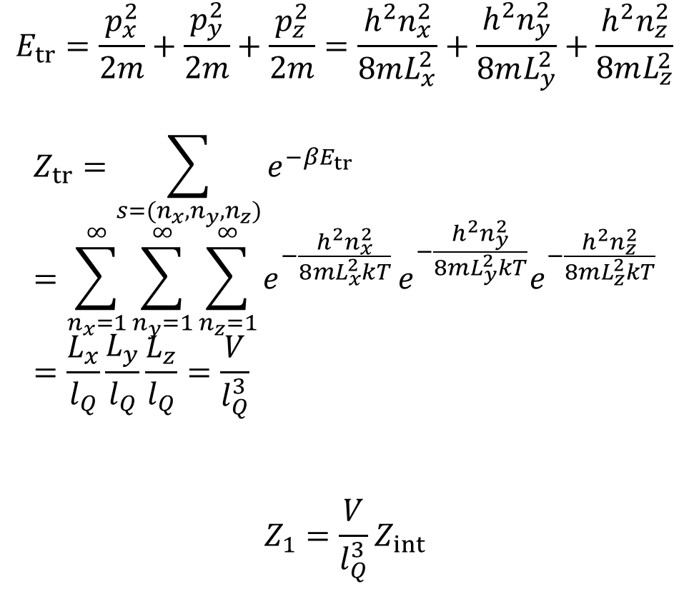



3D box
$$E_{tr}=\frac{p_{x}^{2}}{2m}+\frac{p_{y}^{2}}{2m}+\frac{p_{z}^{2}}{2m}=\frac{h^{2}n_{x}^{2}}{8mL_{x}^{2}}+\frac{h^{2}n_{y}^{2}}{8mL_{y}^{2}}+\frac{h^{2}n_{z}^{2}}{8mL_{z}^{2}}$$
$$Z_{tr}=\sum_{s=(n_{x},n_{y},n_{z})}{e^{−βE_{tr}}}=\sum_{n_{x}=1}^{∞}{\sum_{n_{y}=1}^{∞}{\sum_{n_{z}=1}^{∞}{e^{−\frac{h^{2}n_{x}^{2}}{8mL_{x}^{2}kT}}}}}e^{−\frac{h^{2}n_{y}^{2}}{8mL_{y}^{2}kT}}e^{−\frac{h^{2}n_{z}^{2}}{8mL_{z}^{2}kT}}=\frac{L_{x}}{l_{Q}}\frac{L_{y}}{l_{Q}}\frac{L_{z}}{l_{Q}}=\frac{V}{l_{Q}^{3}}$$
$$Z_{1}=\frac{V}{l_{Q}^{3}}Z_{int}$$
$$L_{z}$$
$$V$$
$$L_{y}$$
$$L_{x}$$
The partition function of a single atom is the counts of volume in units of the quantum volume ${\left(\frac{h}{\sqrt{2πmkT}}\right)}^{3}$.

Slide 16
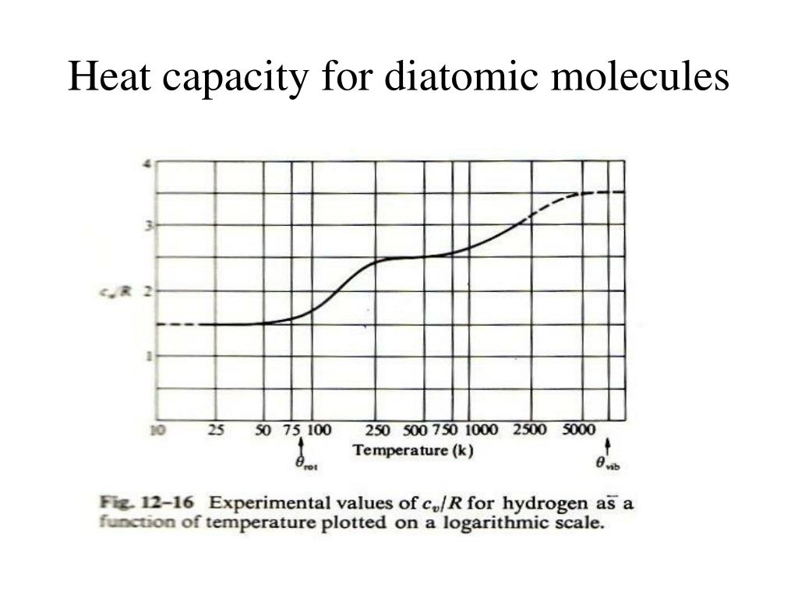
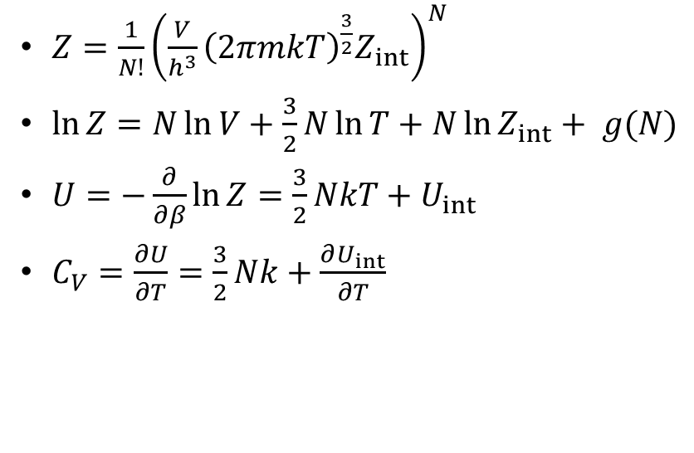
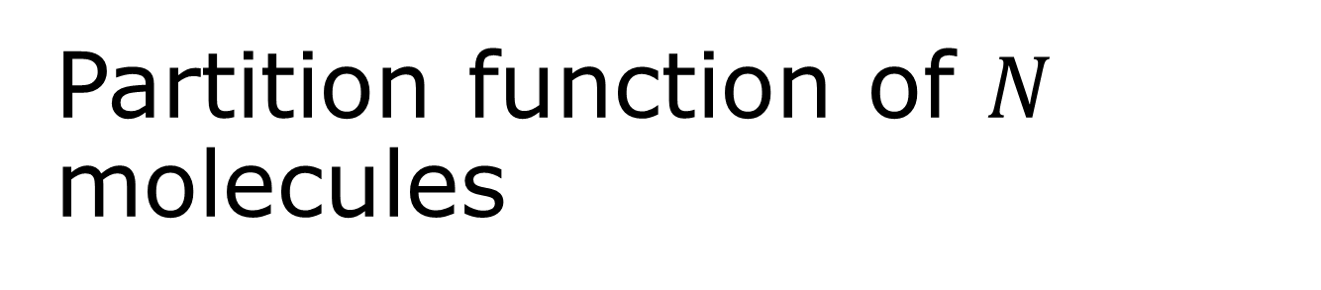
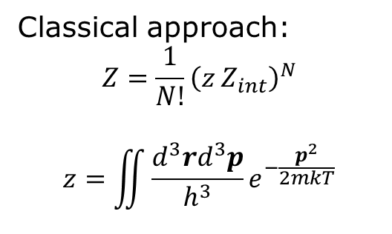
Partition function of $N$ molecules
$Z=\frac{1}{N!}{\left(\frac{V}{h^{3}}{\left(2πmkT\right)}^{\frac{3}{2}}Z_{int}\right)}^{N}$
$\ln{Z=N\ln{V+\frac{3}{2}N\ln{T}+N\ln{Z_{int}}+ g(N)}}$
$U=−\frac{∂}{∂β}\ln{Z}=\frac{3}{2}NkT+U_{int}$
$C_{V}=\frac{∂U}{∂T}=\frac{3}{2}Nk+\frac{∂U_{int}}{∂T}$
Classical approach:
$$Z=\frac{1}{N!}{\left(z Z_{int}\right)}^{N}$$
$$z=\iint{\frac{d^{3}rd^{3}p}{h^{3}}}e^{−\frac{p^{2}}{2mkT}}$$

Slide 17
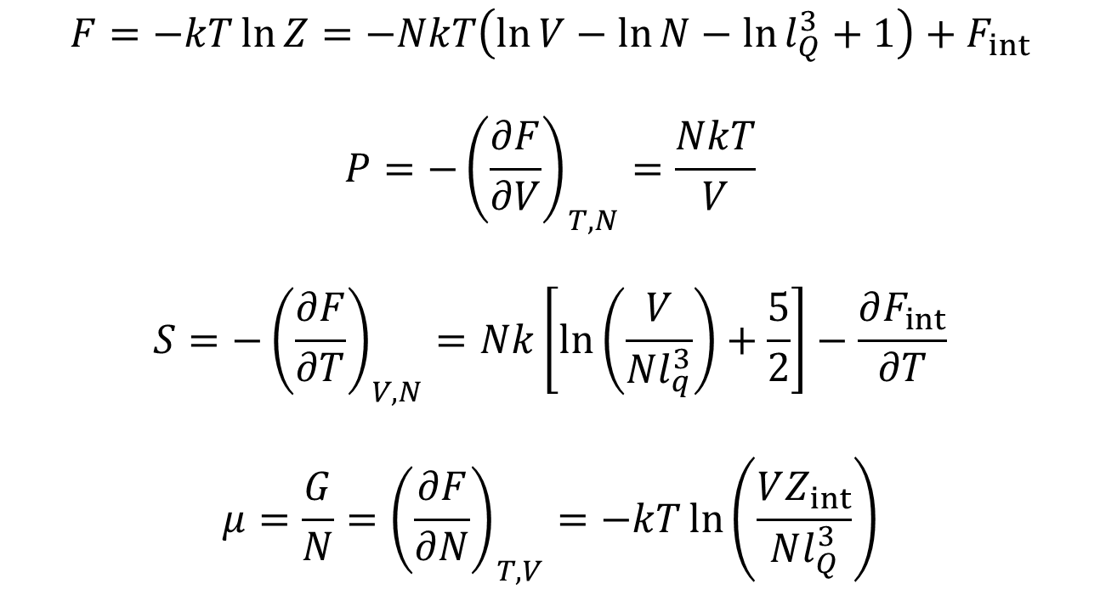
Free energy, etc
$$F=−kT\ln{Z=−NkT\left(\ln{V}−\ln{N}−\ln{l_{Q}^{3}+1}\right)+F_{int}}$$
$$P=−{\left(\frac{∂F}{∂V}\right)}_{T,N}=\frac{NkT}{V}$$
$$S=−{\left(\frac{∂F}{∂T}\right)}_{V,N}=Nk\left[\ln\left(\frac{V}{Nl_{q}^{3}}\right)+\frac{5}{2}\right]−\frac{∂F_{int}}{∂T}$$
$$μ=\frac{G}{N}={\left(\frac{∂F}{∂N}\right)}_{T,V}=−kT\ln\left(\frac{VZ_{int}}{Nl_{Q}^{3}}\right)$$

Slide 18
Tutorial problem 6.10

Slide 19
Tutorial problem 6.31

Slide 22
Tutorial problem 6.40

